Slide 1

CHECKIN
A Mobile Network Quality of Experience (QoE) Monitoring App
Presentation By
GROUP 3
CEF440 - Internet & Mobile Programming
Instructor - Dr Valery Nkemeni
Academic Year: 2024/2025

Slide 2

Introduction
Mobile network users in developing countries like Cameroon often face inconsistent quality, delays, and outages. Traditional network-centric metrics fail to capture real-time, location-specific user experiences.
The "Checkin" app bridges this gap by collecting both subjective feedback (satisfaction ratings) and objective performance metrics (signal strength, latency) directly from subscribers, providing MNOs with deeper insights.

Slide 3

Problem Statement: The Gap in Network Monitoring
Current methods used by mobile network operators primarily focus on network-centric metrics, failing to capture the subjective experiences of users. This leads to an incomplete understanding of service quality from the end-user perspective, especially in developing regions like Cameroon.
There's a significant lack of user-friendly, automated tools that simultaneously collect subjective feedback (e.g., satisfaction ratings) and objective metrics (e.g., network performance data) in real-time. This hinders proactive identification and resolution of network issues, impacting customer satisfaction and loyalty.

Slide 4

Project Objectives: Enhancing QoE Monitoring
1
General Objective
Design and implement a mobile application for real-time collection of user experience data from mobile network subscribers, integrating active user feedback with passive network and device performance monitoring.
2
Specific Objectives
Develop a background-running app for network and device metric collection (e.g., signal strength, latency, location).
Incorporate a user-friendly interface for subjective feedback (satisfaction ratings, comments).
Design a system to log feedback with timestamps and location for correlation with metrics.
Evaluate the app's effectiveness in collecting reliable QoE data and its impact on network optimization.
Ensure adherence to privacy and security standards for user data.

Slide 5
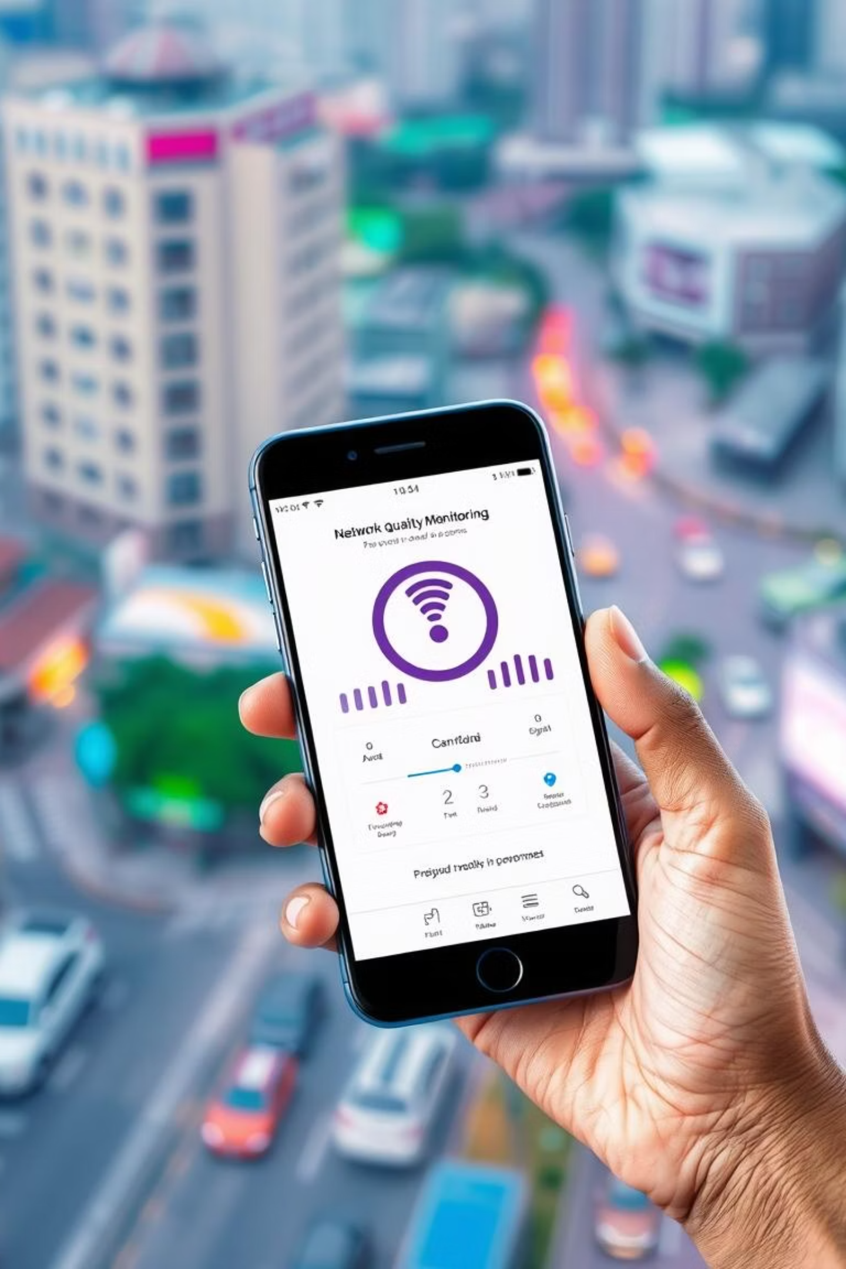
Checkin: Empowering Your Connection
The "Checkin" Mobile Network Quality of Experience (QoE) Monitoring App addresses inconsistent mobile network performance in Cameroon. It enables subscribers to monitor network metrics, submit feedback, and receive alerts, while providing operators and regulators with actionable data.

Slide 6
Methodology: A Systematic Approach
Requirements Engineering
Gathered needs through surveys (50 mobile subscribers) and interviews (MTN staff), identifying key QoE metrics and user concerns like battery efficiency and data privacy.
System Design
Created system models (UML diagrams such as class, use case , sequence , context , ER , deployment) to define the app's architecture, including frontend, backend, and database components, ensuring a user-centric and scalable design.
Implementation
Developed the Android application using React Native for the frontend, Node.js/Express for backend APIs, and MongoDB Atlas for scalable data storage.
Testing & Validation
Conducted usability testing with 20 users, functional tests, and performance evaluations to ensure the app met specified requirements and performed reliably.
Evaluation
Assessed the app's effectiveness in collecting QoE data and its potential impact on network optimization through stakeholder feedback and test results.

Slide 7
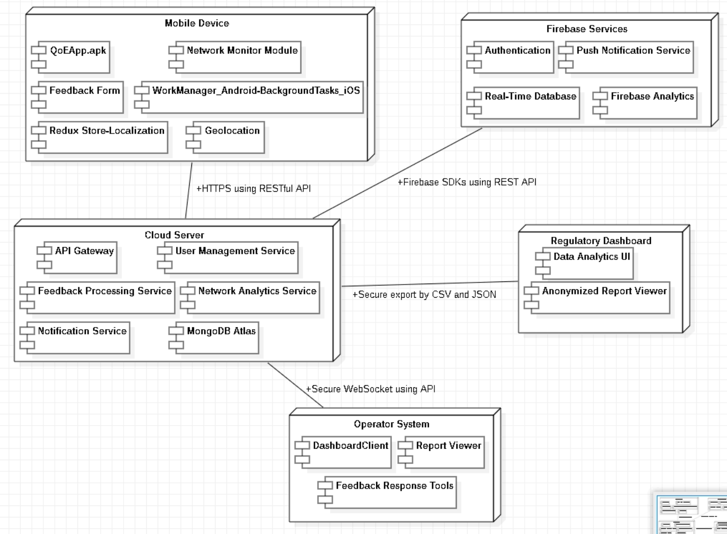
System Architecture: Layered for Scalability
The "Checkin" app adopts a layered architecture, aligning with Clean Architecture principles for modularity and scalability:
Presentation Layer: React Native and TypeScript for cross-platform UI, real-time metrics, feedback forms, and settings. Redux manages state.
Business Layer: Node.js with Express for API services, handling data processing and feedback management.
Data Layer: MongoDB Atlas for scalable, encrypted storage of network metrics, user feedback, and preferences (AES-256 encryption).
Native Bridge Layer: Accesses device APIs (OS Network API, geolocation) via React Native plugins for efficient monitoring.

Slide 8






Key Features: Empowering Users and Operators
Real-time Monitoring
Feedback Submission
Displays internet speed (upload/download), latency, and signal strength in real-time.
Allows users to manually submit feedback with optional geolocation tagging and screenshot uploads.
Network Alerts
Privacy Controls
Notifies users of network drops or outages, enhancing awareness.
Enables users to manage data sharing preferences and ensures end-to-end encryption.
Multilingual Interface
QoE Analytics
Supports both English and French languages for broader accessibility.
Provides aggregated data and reports for mobile network operators and regulatory bodies.

Slide 9
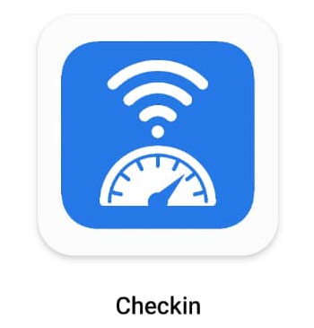
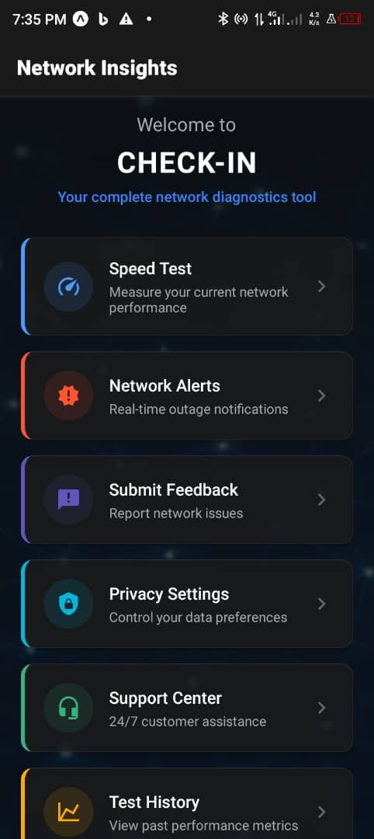
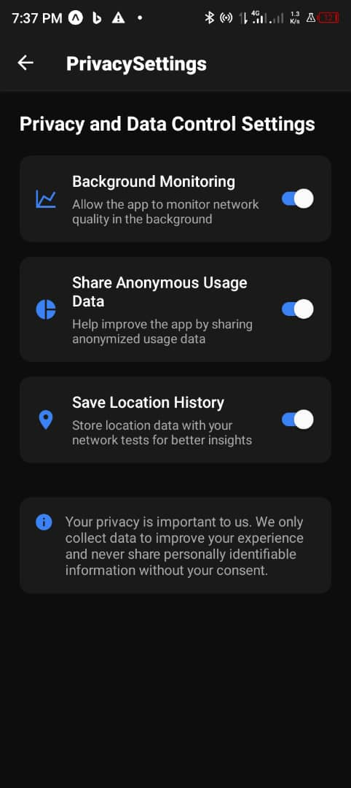
UI Design & Implementation
App Identity: "Checkin"
Tagline: "Empower Your Connection"
Logo: Signal bar with a checkmark.
Color Scheme: Deep green, vibrant blue, bright amber.
Typography: Roboto (Android), San Francisco (iOS).
Key Screens
Dashboard: Real-time metrics.
Feedback Form: Ratings, comments, optional geolocation.
Report History: Past feedback logs.
Settings: Privacy, notifications, language.

Slide 10

Tools & Technologies Used: Building a Robust Solution
Frontend
React Native
TypeScript
Redux
React Navigation
Figma (UI Prototyping)
Backend
Node.js
Express.js
Mongoose
CORS
Database
MongoDB Atlas (Cloud NoSQL)
MongoDB Compass
Other Services
Firebase (Auth, Notifications)
WorkManager (Android)
BackgroundTasks (iOS)
Jest (Testing)
AES-256 Encryption

Slide 11

Testing & Evaluation Results
4.2/5
2.8%
95%
Usability Rating
Battery Usage
Code Coverage
From 20 users, appreciating real-time metrics.
Per hour, well below the 3% target.
Achieved in unit testing, ensuring robust functionality.
300ms
API Response Time
Average, supporting high uptime.
All functional requirements (FR-1 to FR-7) were met, with strong performance in real-time monitoring and privacy controls. Non-functional requirements (NFR-1, NFR-2, NFR-4) were fully achieved. User feedback engagement improved after UI simplifications.

Slide 12





Conclusion & Future Work
The "Checkin" app successfully addresses inconsistent mobile network performance in Cameroon by empowering subscribers, operators, and regulators with real-time data. It integrates innovative QoE monitoring with user feedback, utilizing a scalable cross-platform architecture.
Boost User Engagement
Introduce incentives and gamification for feedback submission.
Scale Infrastructure
Deploy load balancers and auto-scaling for high user loads.
Advanced Analytics
Integrate machine learning for predictive network issue detection.
Commercial Deployment
Partner with operators or regulators for nationwide rollout.

